Slide 1


Department of Computer Science & Engineering (Artificial Intelligence & Machine Learning)
A.P. Shah Institute of Technology
G. B. Road, Kasarvadavli, Thane(W)
Mumbai-400615
UNIVERSITY OF MUMBAI
Academic Year 2023-2024

Slide 2
AI Powered Interactive Workout Assistant for Form Detection & Correction
Computer Science & Engineering
(Artificial Intelligence and Machine Learning)
By
Siddhesh Dige (21106017)
Abhishek Bapat (21106008)
Tanisha Chitnis (21106003)
Shlok Dalvi (21106012)
Under the Guidance of
Prof. Taruna Sharma

Slide 3
Index
Introduction
Objectives
Features
Literature Survey
Block Diagram
Technology Stack
Models
Future Scope
Conclusion
References

Slide 4
Introduction
The main goal of the AI Gym Assistant project is to develop an AI-powered virtual fitness assistant.
It enhances the gym-goers' workout experience and supports them in achieving their fitness goals.
It also helps the gym-goer’s to improve their form during their workout.
Ultimately, the AI Gym Assistant aims to be a valuable tool for common people, empowering them on their journey towards a healthier and fitter lifestyle.

Slide 5
Objectives
Helps to track reps and sets accurately and consistently.
Easy to use with voice assistant.
Aims to provide form detection and correction.
To Enhance user’s experience by exercise report.
Easy to use and affordable.

Slide 6
Features
Progress Tracking: The assistant keeps track of users' workout progress reps and sets.
Form Detection: The AI gym assistant detects the exercise form-bicep, squat, deadlift etc.
Form Correction: The AI gym assistant detects the wrong exercise form-bicep, squat , deadlift etc.
User - friendly UI: The AI Gym Assistant is accessible through a user-friendly UI.
AI Voice Assistant: Voice assistant enables the user to access the UI.
Report Generator: A report will be generated at the end of users workout.

Slide 7
Literature Survey
Sr. No | Title | Author Name | Description
1. | Learning OpenCV--- Computer Vision with the OpenCV Library | Bradski, G.R. et al. | The textbook explains how to install OpenCV and gets you started with simple examples with single images and then onto video, and working with the all important graphical user interface (GUI). The textbook addresses the education market by providing an extensive set of exercises at the end of each chapter.

Slide 8
Sr. No | Title | Author Name | Description
2. | Pose Estimation from corresponding point data | R.M. Haralick; H. Joo; C. Lee; X. Zhuang; V.G. Vaidya; M.B. Kim | Solutions for four different pose estimation problems are presented. Closed-form least-squares solutions are given to the over constrained 2D-2D and 3D-3D pose estimation problems. A globally convergent iterative technique is given for the 2D-perspective-projection-3D pose estimation problem.

Slide 9
Sr. No | Title | Author Name | Description
3. | Generative Modeling of Pseudo-Whisper for Robust Whispered Speech Recognition | Ghaffarzadegan, Shabnam, Hynek Bořil, and John HL Hansen. | The study addresses challenges in recognizing whispers due to a lack of transcribed datasets. Two strategies, Vector Taylor Series (VTS) and denoising autoencoders (DAE), are proposed to adapt speech recognition models using minimal untranscribed samples. Results show significant improvements in word error rates for a whisper recognition task, indicating the effectiveness of these strategies.

Slide 10
Sr. No | Title | Author Name | Description
4. | Speech-to-text and speech-to-speech summarization of spontaneous speech | Furui, Sadaoki, Tomonori Kikuchi, Yosuke Shinnaka, and Chiori Hori. | The study proposes integrating speech and text autoencoders with automatic speech recognition (ASR) models to improve ASR performance using extensive datasets. These autoencoders, based on advanced ASR and text-to-speech (TTS) encoder-decoder architectures, alternate between encoders and decoders to learn features from speech-only and text-only datasets.

Slide 11
Sr. No | Title | Author Name | Description
5. | AI-Based Workout Assistant and Fitness Guide | Gourangi Taware; Reena Kharat; Pratik Dhende; Prathamesh Jondhalekar; Rohit Agrawal | We have created a system that keeps track of body movements and provides us with the number of repetitions performed, if performed within the foundation of the model. Our system also provides audio instruction to the user when performing the exercise inappropriately, and with the assistance of the user's physical measurements and his/her diet, the system is able to keep track of the user's calorie intake and recommends a certain amount of calorie intake to be followed in order to achieve normal Body Mass Index in order to stay fit.

Slide 12
Block Diagram

Slide 13
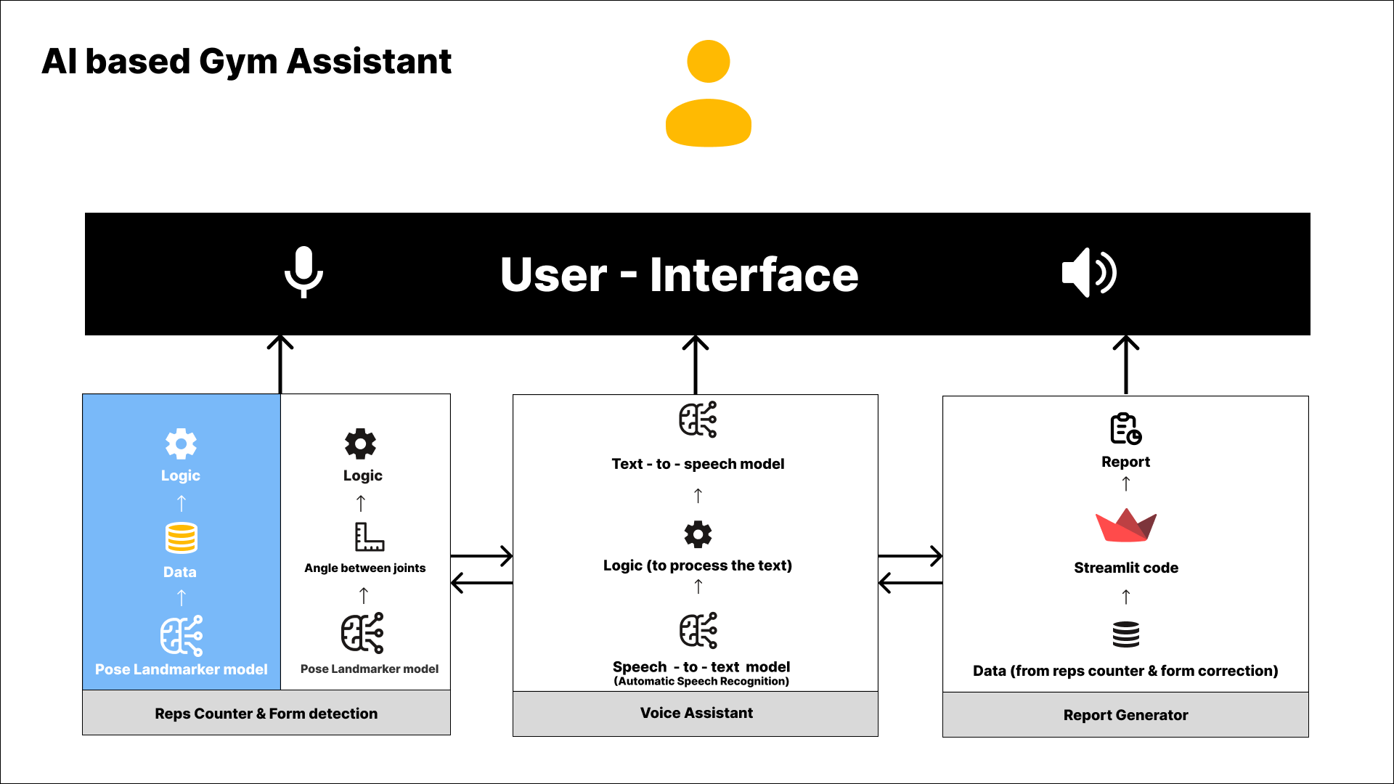

Slide 14





Technology Stack:
Editor :
Jupyter Notebook / Colab
Pycharm
Libraries :
OpenCV
Numpy
Pandas
Mediapipe
Scikit-learn
Streamlit

Slide 15
Models
Whisper-large (Automatic speech recognition) : Whisper is a pre-trained model for automatic speech recognition (ASR) and speech translation. Trained on 680k hours of labelled data. Whisper was proposed in the paper Robust Speech Recognition via Large-Scale Weak Supervision by Alec Radford et al from OpenAI.
SpeechT5 (text –to- speech) : This model was introduced in SpeechT5: Unified-Modal Encoder-Decoder Pre-Training for Spoken Language Processing by Junyi Ao, Rui Wang, Long Zhou, Chengyi Wang, Shuo Ren, Yu Wu, Shujie Liu, Tom Ko, Qing Li, Yu Zhang, Zhihua Wei, Yao Qian, Jinyu Li, Furu Wei.

Slide 16
Future Scope:
The AI gym assistant will help in improving the wrong form of user by form correction.
The voice assistant enabled with the app helps the user to interact with ease.
An exercise report will be generated after completion of a repetition.

Slide 17
Conclusion:
The AI gym assistant has achieved its goals by successfully implementing form detection for the following exercises- pushups, biceps, deadlift and squats.
Usage of MediaPipe, Scikit-learn and OpenCV proved helpful .
The dynamic user interface created by streamlit adds value to existing model thus making it a full fledged software.

Slide 18
References:
Journal Papers
[1] Zelinsky, Alex. "Learning OpenCV---Computer vision with the OpenCV library (Bradski, GR et al.; 2008)[On the Shelf]." IEEE Robotics & Automation Magazine 16, no. 3 (2009): 100-100.
[2] Haralick, Robert M., Hyonam Joo, Chung-Nan Lee, Xinhua Zhuang, Vinay G. Vaidya, and ManBae Kim. "Pose estimation from corresponding point data." IEEE Transactions on Systems, Man,and Cybernetics 19, no. 6 (1989): 1426-1446.
[3] Ghaffarzadegan, Shabnam, Hynek Bořil, and John HL Hansen. "Generative modeling of pseudo-whisper for robust whispered speech recognition." IEEE/ACM Transactions on Audio, Speech, and Language Processing 24, no. 10 (2016): 1705-1720.

Slide 19
[4] S. Furui, T. Kikuchi, Y. Shinnaka and C. Hori, "Speech-to-text and speech-to-speech summarization of spontaneous speech," in IEEE Transactions on Speech and Audio Processing, vol. 12, no. 4, pp. 401-408, July 2004.
[5] Taware, Gourangi, Reena Kharat, Pratik Dhende, Prathamesh Jondhalekar, and Rohit Agrawal. "AI-based Workout Assistant and Fitness guide." In 2022 6th International Conference On Computing, Communication, Control And Automation (ICCUBEA, pp. 1-4. IEEE, 2022.
Useful Links: https://developers.google.com/mediapipe
https://huggingface.co/models
https://docs.streamlit.io/

Slide 20
THANK YOU

